Slide 1

Are you tired of having food in your fridge that you just don’t know what to do with?

Slide 2

Are you hungry for something but just can’t make up your mind?

Slide 3

Do you find yourself accidentally ruining your roasts and disguising yourself as stretching your calves on the windowsill?

Slide 4

There’s got to be a better way!

Slide 5
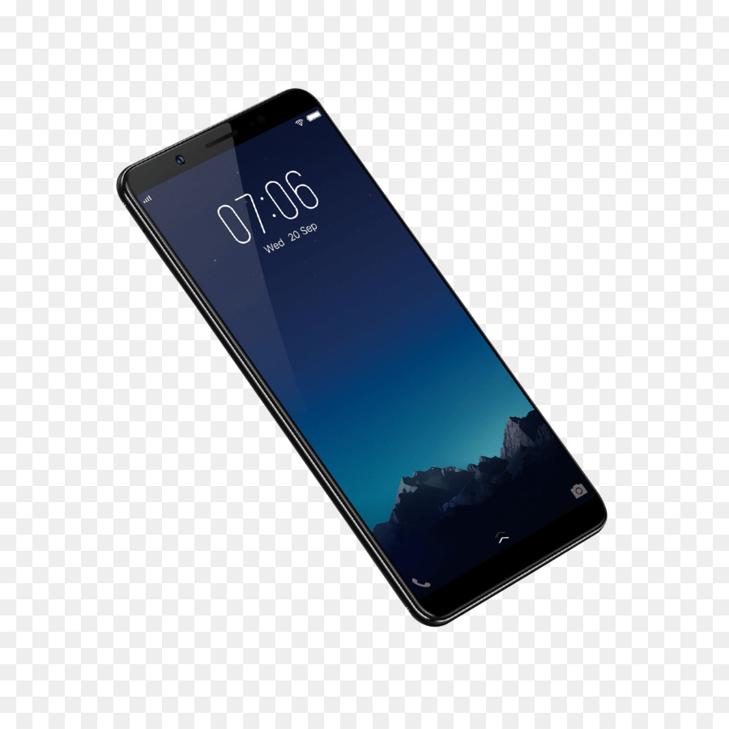
Introducing ‘Frecipe’, a new way to decide on your next meal!

Slide 6

Frecipe downloads to your mobile device or desktop computer from all leading app stores and simplifies your meal choices by assessing…

Slide 7

With its sleek design and modern interface, you’ll find Frecipe a breeze to use. The built-in help function makes using the app simple with plain English explanations of how to perform tasks.

Slide 8
The main attraction of Frecipe is its ability to smart scan your fridge (and pantry!) meaning the addition of items to your stock within the app is simplified. You can also manually add or remove items if required.

Slide 9
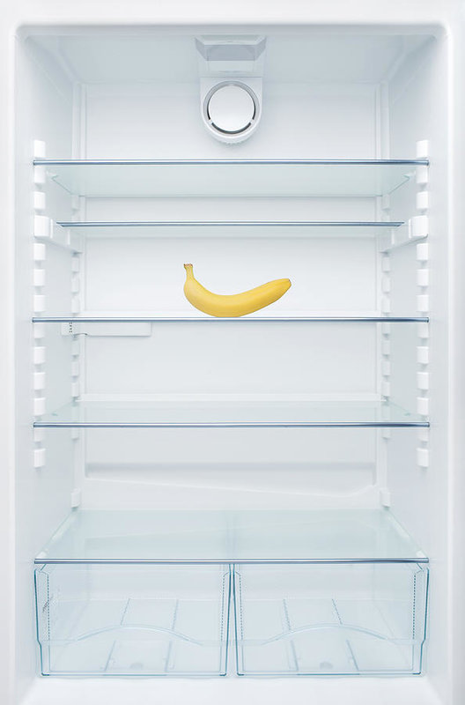
Is your fridge looking a little bare? Not to worry! Frecipe, if it can’t suggest any recipes using only what you have, will then suggest recipes requiring minimal additional items!

Slide 10
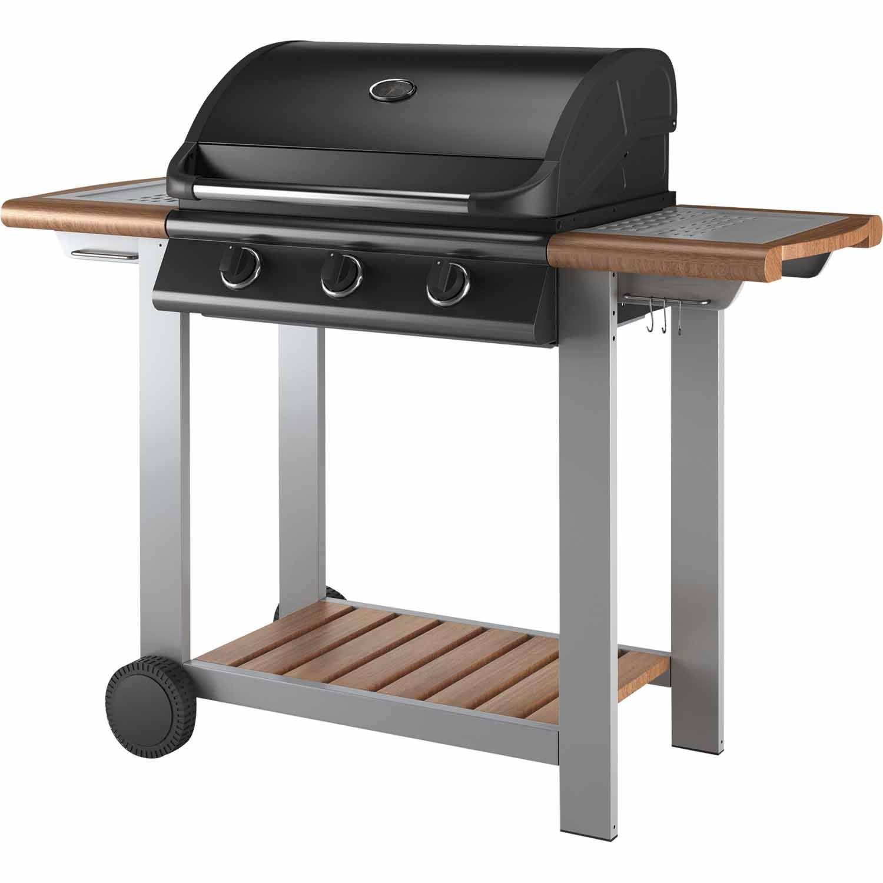
Whether it’s baking, breakfast, lunch, dinner, high tea with the girls or a BBQ with the lads, Frecipe has you covered!

